Slide 1
Reconquest of Buenos Aires
E.T.N°29 D.E 6°
Prof.: Marcela Otero
Prof.: Luis Marta
Presentado por:
Brian Rojas Inclán.
3°7°
Jorge Luis Chacón Balcazar.

Slide 2
Ernesto Grafman
Ernesto Grafman is an Argentine painter recognized throughout the district of boedo who also was an art teacher.
He participated in competitions for his paintings and got the first place.
Some of his works are part of our gallery and then some teachers donated a painting so the gallery was called Ernesto gallery Grafman.

Slide 3
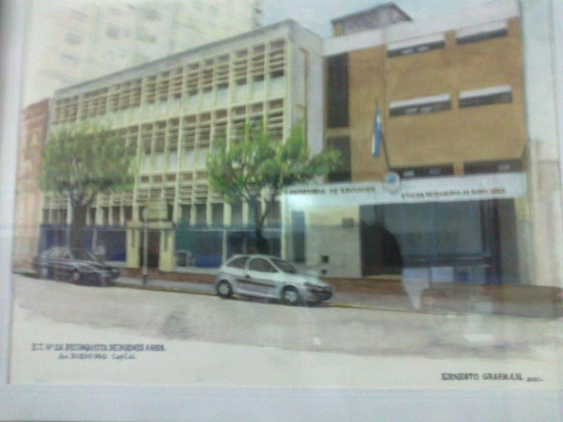
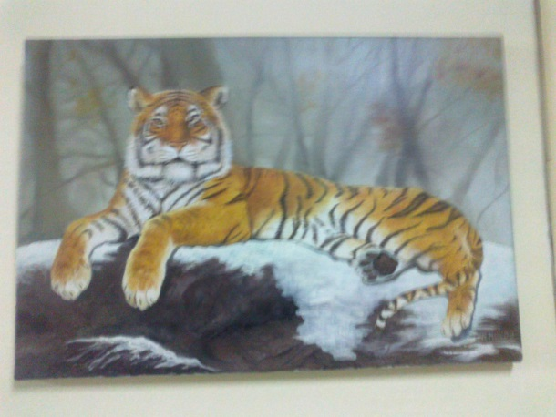
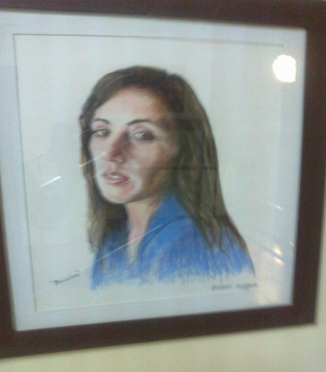
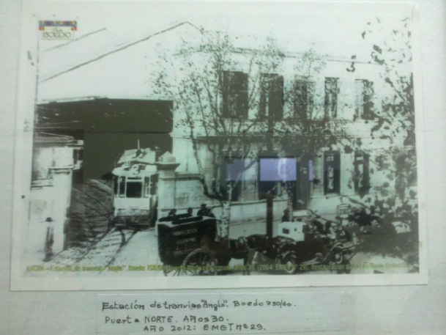
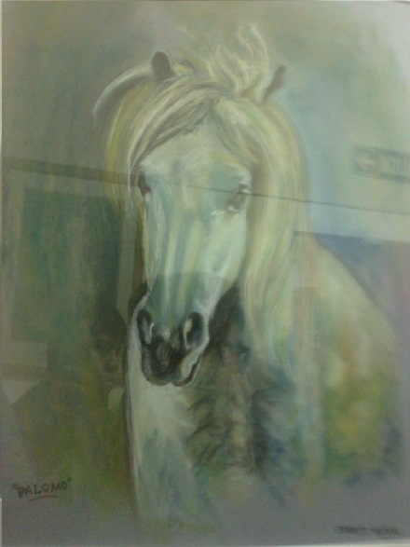
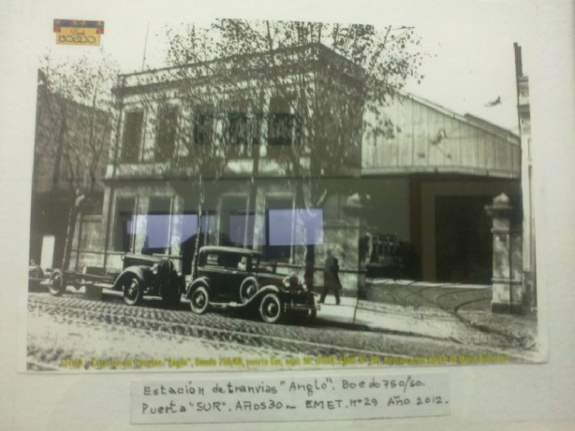
Some of his paintings in the gallery.

Slide 4
One of the most famous paintings of Ernesto Grafman.
This is a work of Prof. Ernesto Grafman, emerged from the contest organized by the Directorate General of Political and Legislative Affairs through its program Strengthening Institutional Participation (FoPaI). The emblem was placed on one side and display located in San Ignacio boedo October 21 of 2004.The renowned illustrator and artist, a resident of the neighborhood, designated as founding landmarks of the neighborhood, its spirit of freedom, the existence of their clubs, the artistic activities, music and letras.The shield is divided into two camps: the top, over white, highlights the Editorial Clarity activity, emerging a flame torch red, which symbolizes the ideals Boedo. In Group the lower field, on gray-blue, right, a palette reminiscent of artists. On the left, the open book and pen with the inscription commemorates Pacha Camac traditional peña. Both representations, tango, symbolized by the bandoneon, and two intertwined dancers complete the allegory. In the lower limit, two tapes Argentine holding a red ribbon with the name of the neighborhood in blue.

Slide 5
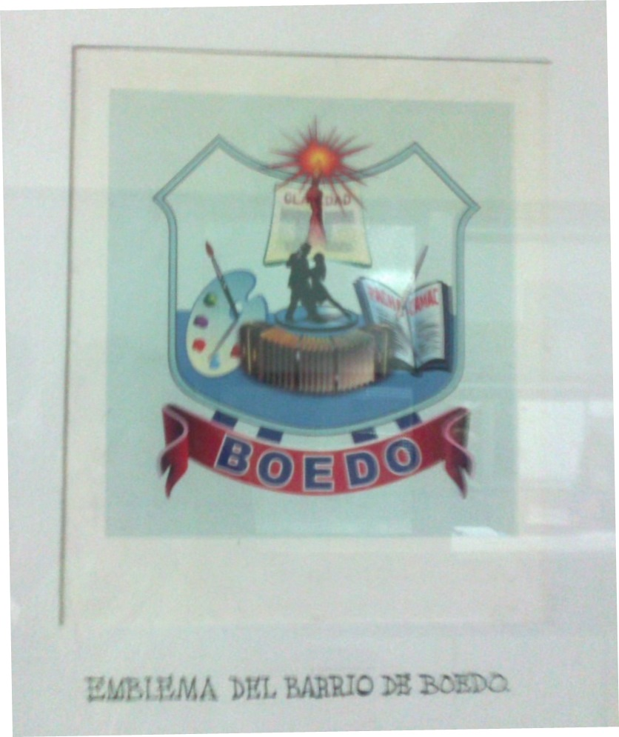
Neighborhood emblem Boedo

